Slide 1
Software Engineering
Module: Web UI Programming
Topic: HTML

Slide 2
HTML Basics
The content in this presentation is aimed at teaching learners to:
Create web pages using frames
Insert HTML input controls in the webpage
Notes:
Instructor Notes:
By the end of this course, participants should be able to:
<Obj1>
<Obj 2>

Slide 3
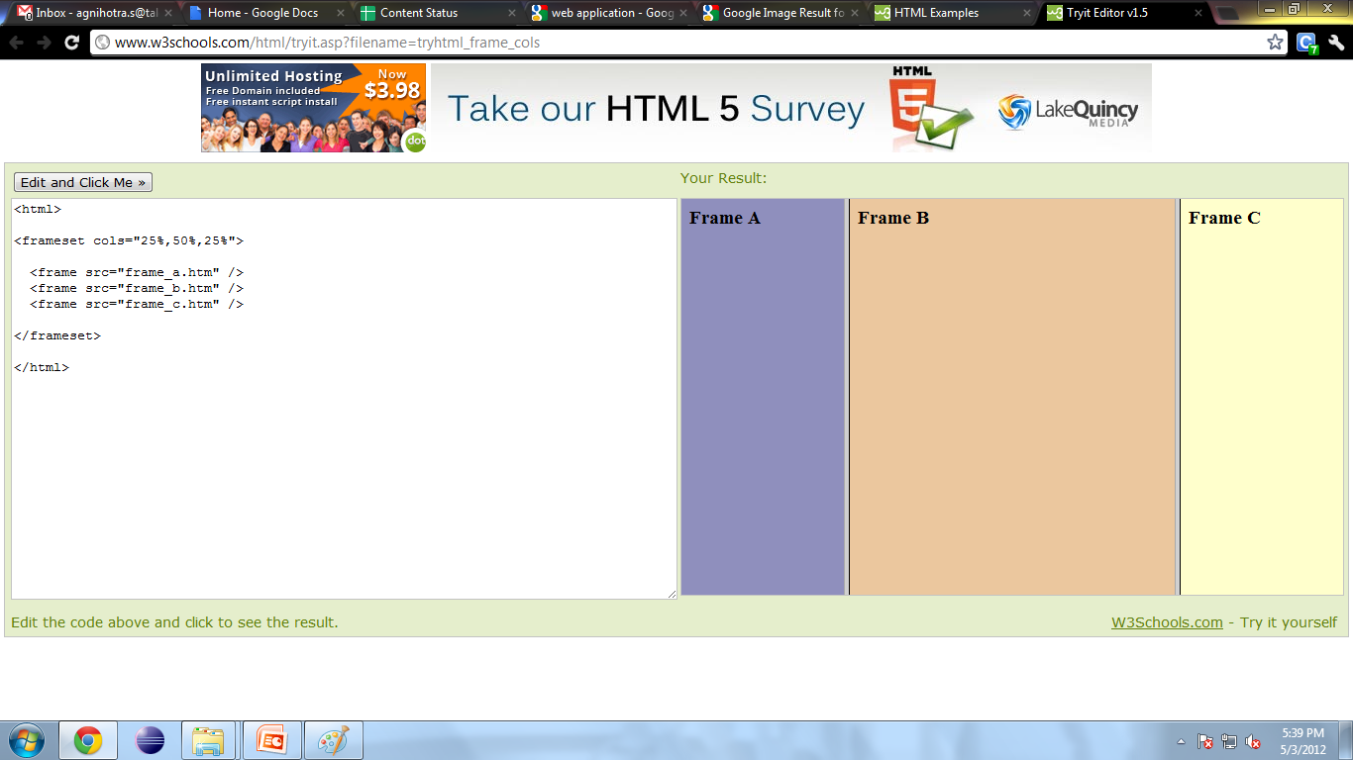
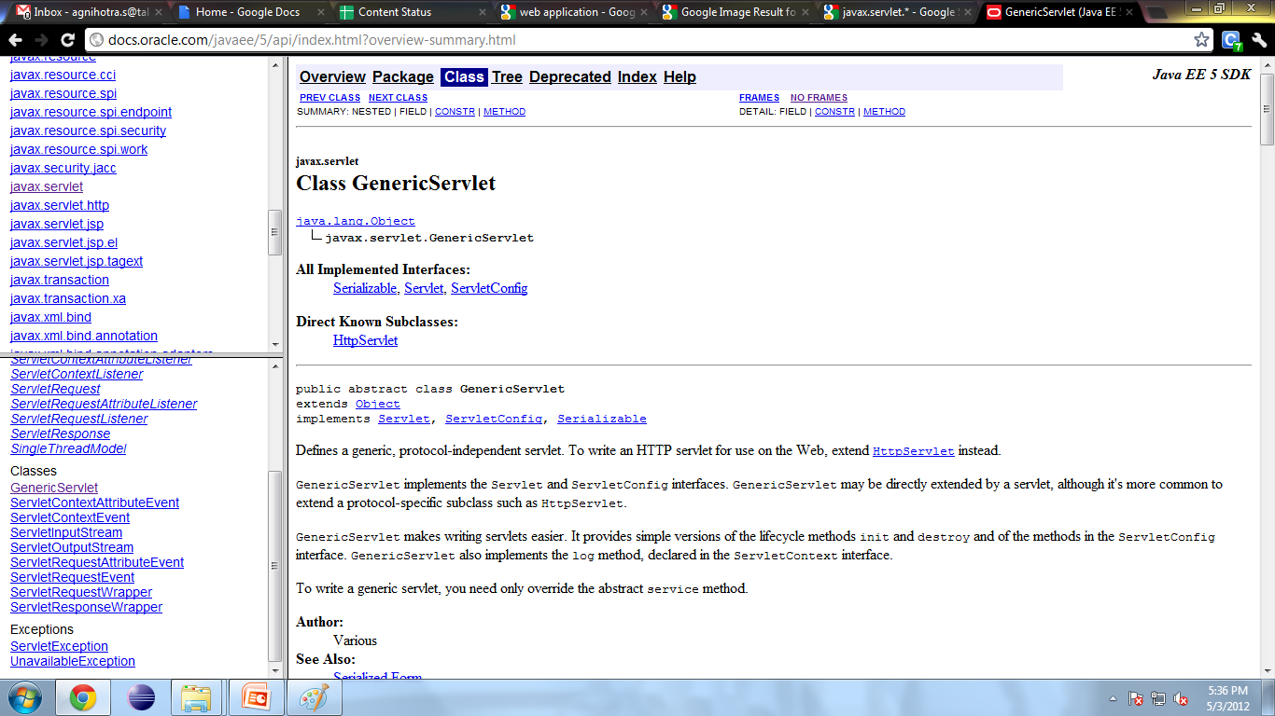
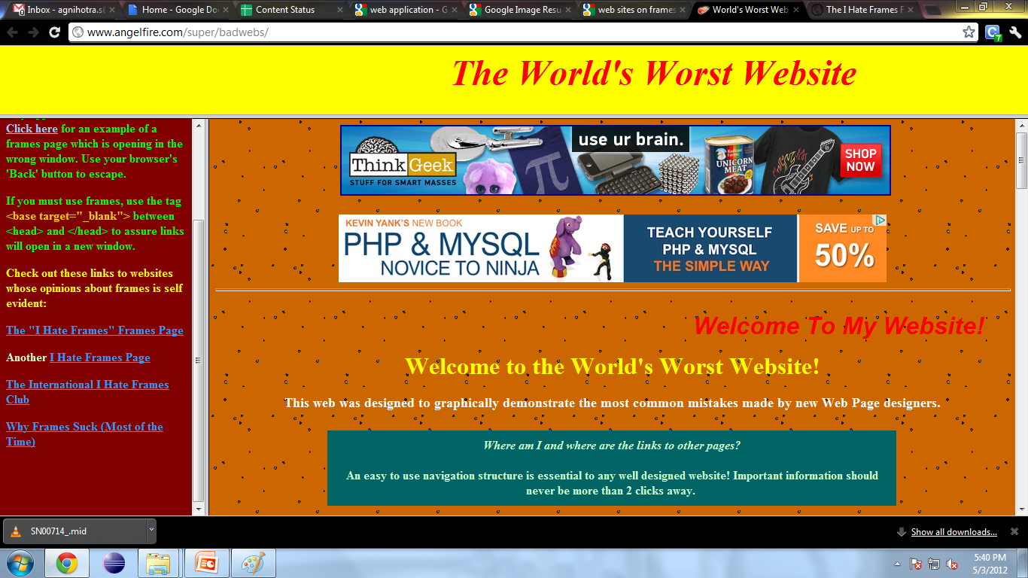
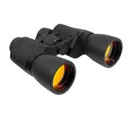
Frame and Form Controls
Observe the Screens
All these webpages are created by using frames.

Slide 4
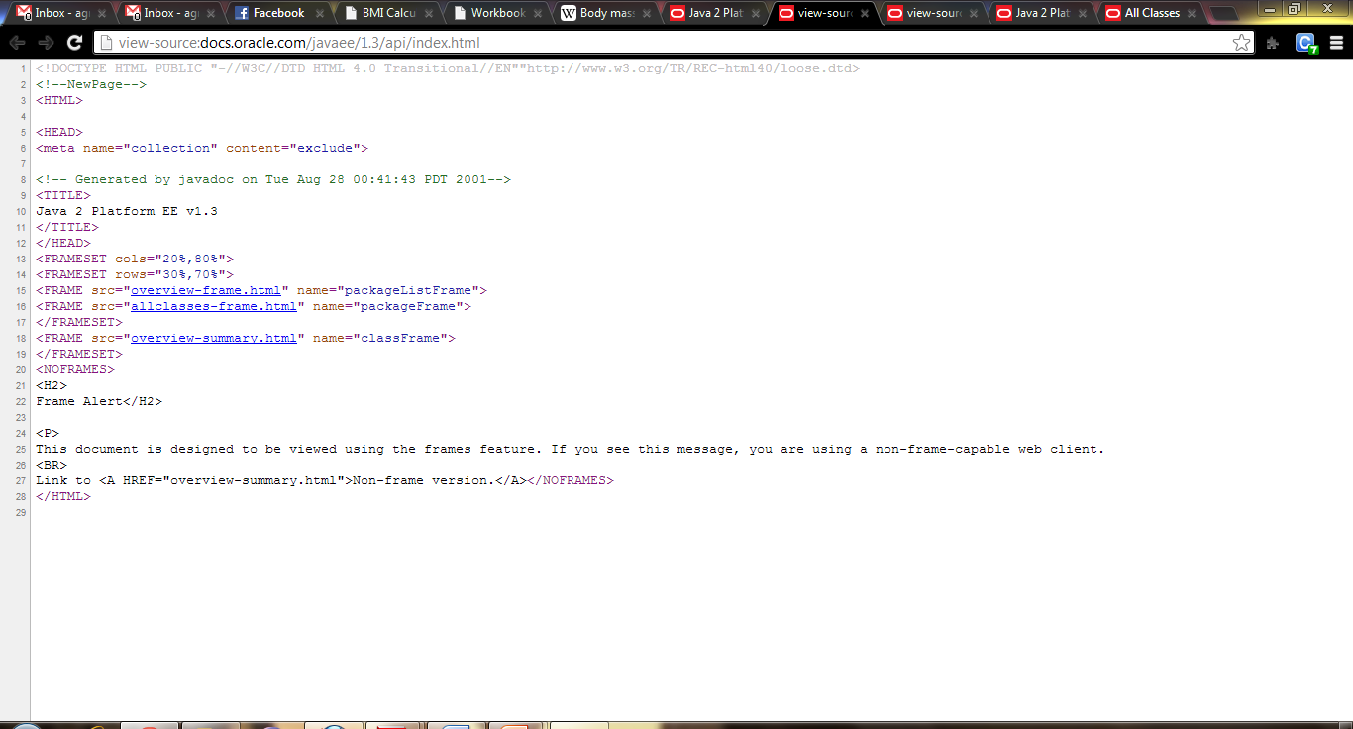
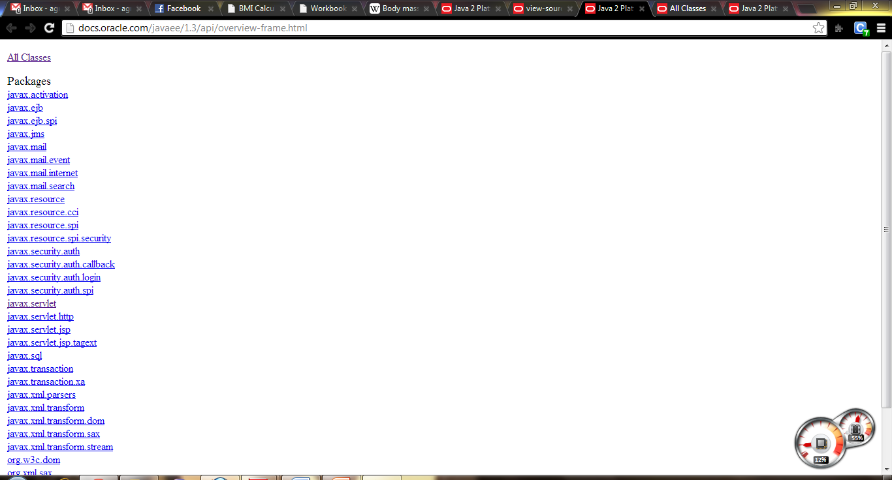
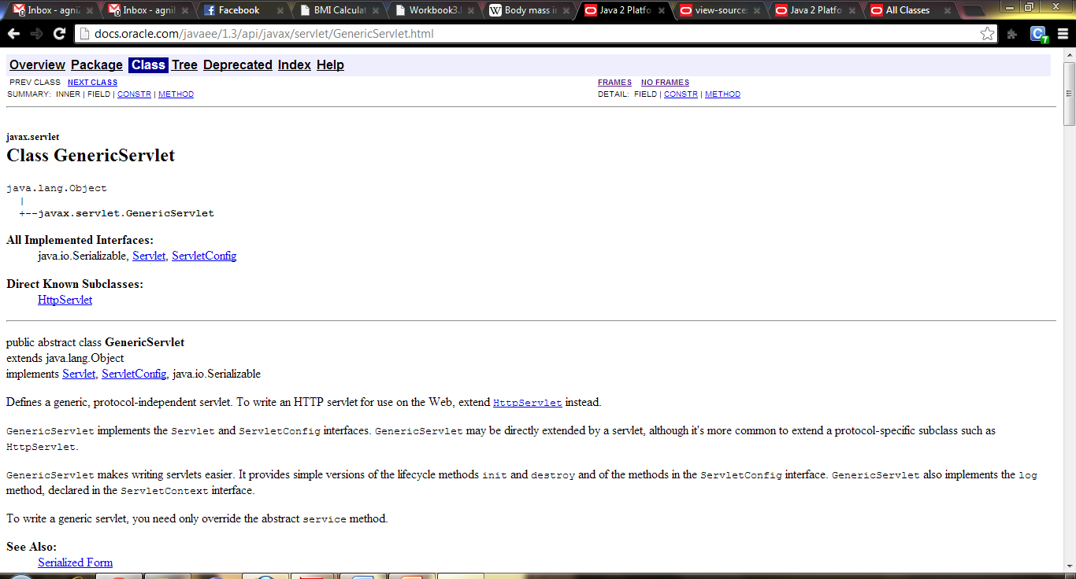
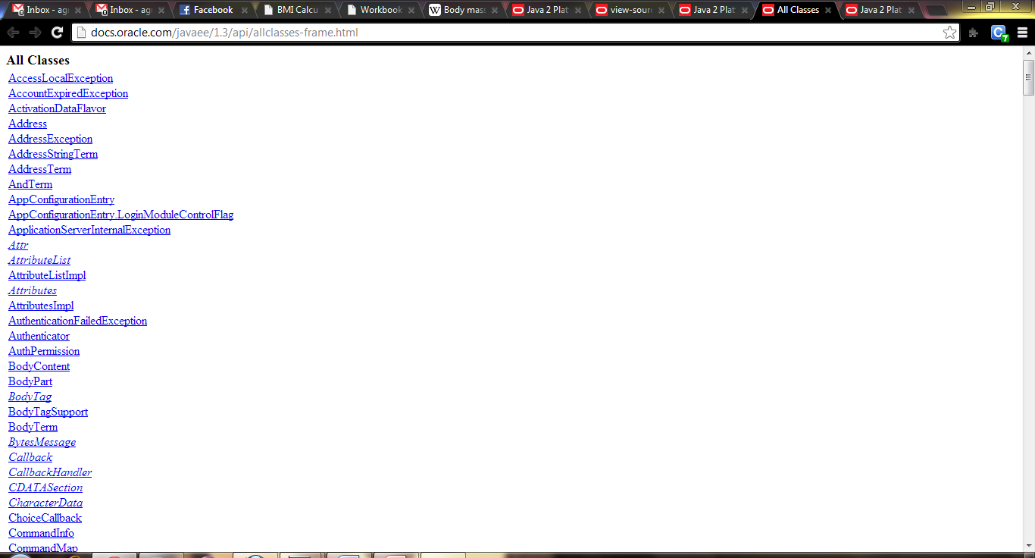
Frame and Form Controls

Slide 5

Frame and Form Controls

Slide 6
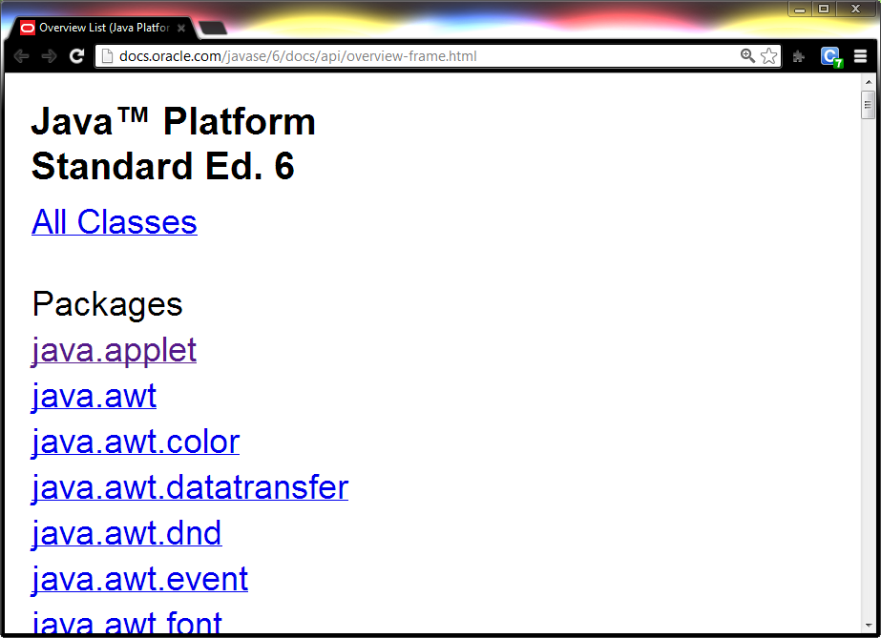
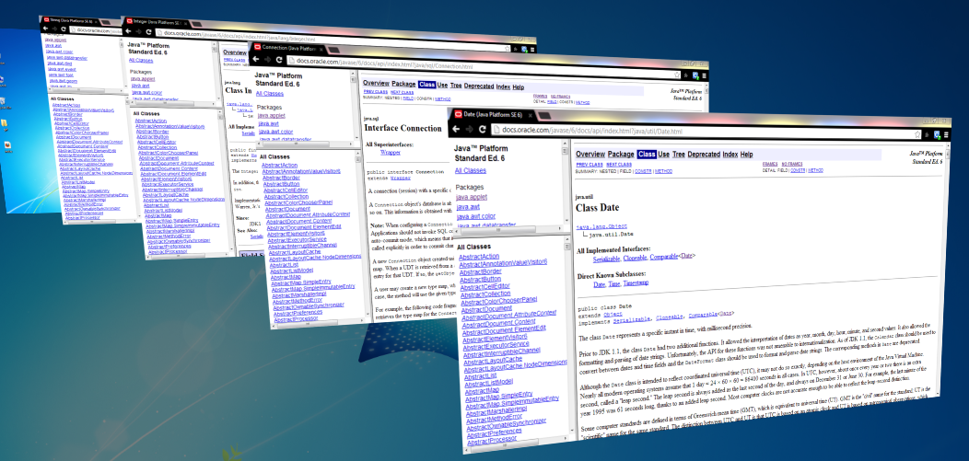
Frame and Form Controls
Reusable

Slide 7
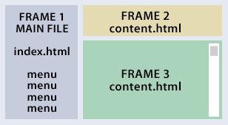


Frame and Form Controls
Frameset
Divides the screen into separate frames.
Each frame can contain an HTML document.
A file or HTML Document that specifies how the screen is divided into frames is called a frameset.
If you want to make a homepage that uses frames, you should:
Create an HTML document with the frameset,
Create the normal HTML documents that should be loaded into each of these frames.

Slide 8
Frame and Form Controls
Creating Frameset
A frameset is simply an HTML document that tells the browser how to divide the screen into split windows.
Example:
<frameset cols="120,*">
</frameset>
‘Cols’ is an attribute to divide the window into to columns
The left being 120 pixels and the right using the rest of the screen (indicated by the *).
‘Rows’ is an attribute to divide the frame into to rows

Slide 9
Frame and Form Controls
Creating Frameset
The values of rows and columns can be in pixels value or can be percentage value of screen space.
Number of rows or columns seperated with commas, decides the number of frames in the page.
Frameset tag will not work in <body> tag.

Slide 10
Frame and Form Controls
Defining Frame
The <frame> tag defines one particular window (or frame) within a frameset.
You can add default pages to the frames by using the src attribute of the frame tag.
You can add names to each frame by using the name attribute.

Slide 11
Frame and Form Controls
Defining Frame
Name attribute allow us to display a link in one frame and open the page in another frame .
Example:
<frameset cols="120,*" >
<frame src="menu.htm" name="menu" >
<frame src="front.htm" name="main" >
</frameset>
menu | front
Comma separated values of row/cols in frameset will maps to the list of frames defined in frameset respectively.

Slide 12
Frame and Form Controls
Attributes for Frame and Frameset
frameborder
Specifies whether or not to display a border around a frame.
‘0’ means no border
Any numerical value other than ‘0’ shows the border
width
Specifies the width of the border in pixels/percentage
noresize
Specifies that a frame is not resizable
scrolling
Specifies whether or not to display scrollbars in a frame.
Values are yes, no and auto

Slide 13


Frame and Form Controls
TRY IT
Welcomepage.html
Menupage.html
Bottombanner.html
<frameset cols="120,*" scrolling=auto>
<frame src="menupage.htm" name="menu“ noresize>
<frameset rows="*,50" frameborder=1 border=10>
<frame src="welcomepage.htm" name="main">
<frame src="bottombanner.htm" name="bottom">
</frameset>
</frameset>

Slide 14
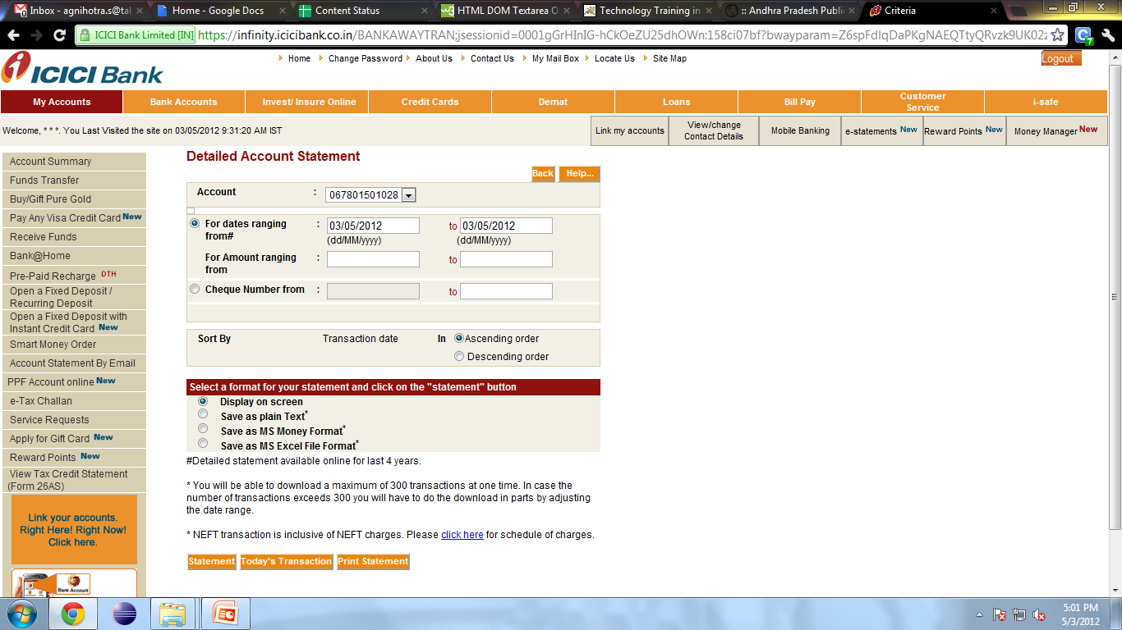
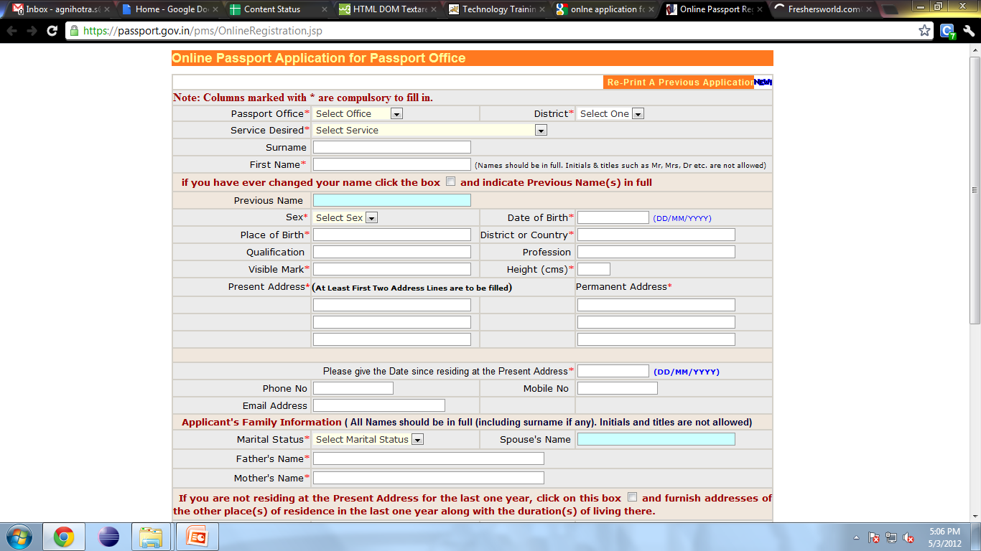
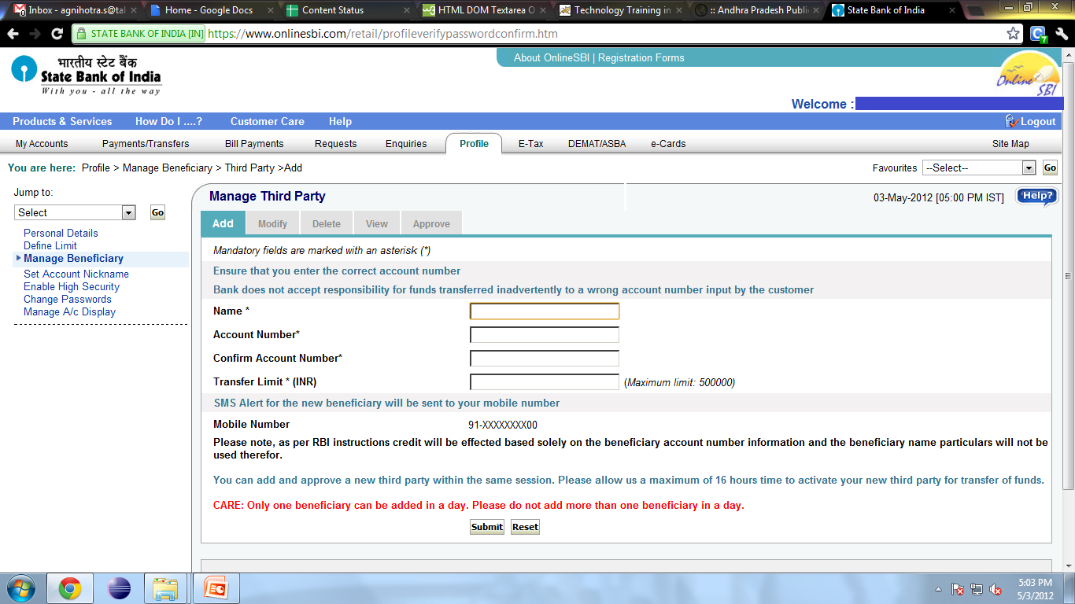
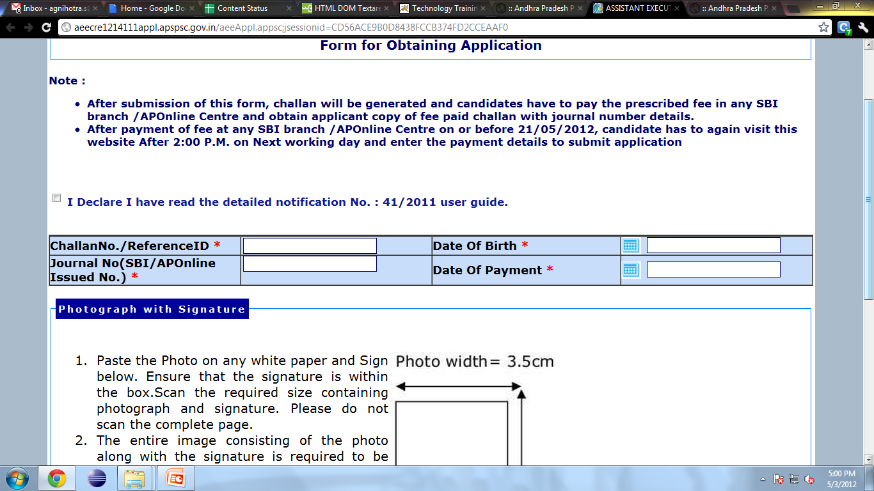
Frame and Form Controls
Observe these other set of screens
What is the Difference between these two sets of screens?
Data (Input) Acceptance

Slide 15

Frame and Form Controls
What after Acceptance?
Web Server
HTTP
Request
Process
Request
Web
Components
Web
Client
HTTP
Response
1
Validates Inputs
Accepting only numbers
Mandatory Fields
Passwords matches .. Etc
For all the above we need validation at Client Side
2
Sends data for further processing like Insert, Updates and Calculates Computational Tasks by:
Generates the REQUEST
Transfers the Data to the Sever
3
Server Process the request and responds back as necessary.

Slide 16
Frame and Form Controls
Challan No. / ReferenceID * |  | Date Of Birth *
Journal No * |  | Date Of Payment *
A form is an area that can contain form fields.
Form fields are objects that allow the visitor/user to enter information.
When the user clicks the submit button, the content of the form is usually sent to a program that runs on the server.

Slide 17
Frame and Form Controls
Form Tag
<form> tells the browser where the form starts and ends.
Includes all kind of HTML tags between <form> and </form>.
To specify where to send the content, we have to add these properties to the <form> tag
action=<url>
method=< POST | GET >
The address is the url of the cgi script where the content should be sent to.
POST and GET methods are simply two different methods of submitting data to the script.

Slide 18
Frame and Form Controls
Form Tag Example
<html>
<head>
<title>My Page</title>
</head>
<body>
<!-- Here goes HTML -->
<form method="post" action=“http://www.echoecho.com/cgi-bin/formmail.cgi”>
<!-- Here goes form fields and HTML -->
</form>
<!-- Here goes HTML -->
</body>
</html>

Slide 19
Frame and Form Controls
Form Field | UI Presentation | HTML Code
Text Filed |  | <input type=“text”>
Password |  | <input type=“password”>
Hidden Field |  | <input type=“hidden”>
Text Area |  | <textarea width=20 height=5> </textarea>
Check Box |  | <input type=“checkbox”>CheckBox1
Radio Button |  | <input type=“radio”>Red
Drop-Down Menu |  | <select> <option value=1>1st Year</option> .. </select>
Submit Button |  | <input type=“submit”>
Reset Button |  | <input type=“reset”>
Image Button |  | <input type=“file”>

Slide 20
Frame and Form Controls
Form Submission
This is what may happens when the form is submitted:
Performs the Client Side Scripting
Generates HTTP Request according to Specifications (GET/POST)
Transfer the form data to the server side scripting
Server process the request to perform the particular task

Slide 21
Frame and Form Controls
Input Attributes
Attribute | Value | Description
Size | Number | Characters to be shown
Maxlength | Number | Max Characters allowed
Name | Text | Name of the Field
Value | Text | Initial value in the field
Align | Left ,Right, Center | Alignment of the field
Tabindex | Number | Tab order of the field
Type | Text, Password, Checkbox, Radio, Submit, Reset, Button, Hidden, File, Image | Specifies the type of <input> element
Checked | Checked | Specifies element should be preselected (for type="checkbox" or type="radio")
Disabled | Disabled | Element should be disabled
Readonly | Readonly | Element is un editable

Slide 22
Frame and Form Controls
Text Area
Text areas are the text fields that can span several lines
Text areas are not defined with an <input> tag
Everything written between <textarea> and </textarea> tags will be presented in the text area box.
Attribute | Value | Description
Rows | Number | Rows in the field
Cols | Number | Columns in the field
Name | Text | Name of the field
Tabindex | Number | Tab Order of the field
Wrap |  | Turns off line breaking

Slide 23
Frame and Form Controls
Dropdown Menu
It serves the same purpose as:
Radio buttons (one selection only)
Check boxes (multiple selections allowed)
It has combine usage of <select> and <option>
Both tags have an opening and a closing tag
Disadvantage is that all options are not visible unless the menu is selected.

Slide 24
Frame and Form Controls
Dropdown Menu
Attribute | Value | Description
Name | Text | Name of the element
Size | Number | No . of options to display
Multiple | Multiple | Allows multiple selection
Value for option tag | Text | Value of the selection
<select name=‘food’ multiple>
<option>Fresh Milk</option>
<option>Old Cheese</option>
<option>Hot Bread</option>
</select>

Slide 25
Frame and Form Controls
Buttons
Three type of buttons based on input type:
Button: Normal button
Submit: Button which submits the form
Reset: Button which sets the form data to the default values

Slide 26
Frame and Form Controls
Write the code to create a webpage containing the following form:
TRY IT
Name
Mobile Number
Skill
Year
Address

Slide 27

Frame and Form Controls

